Slide 2
Presented by
Notes:
Before we begin, we want to take a moment to recognize Julie Sweetland at the FrameWorks Institute for drafting this brief “Reframing Childhood Adversity: Promoting Upstream Approaches.” This report was commissioned by Prevent Child Abuse America and Social Current with support from the Department of Justice. Our partners at FrameWorks and Rally also contributed to this presentation.

Slide 3
Notes:
Today in our presentation, we have three objectives:
Learn how to reframe the narrative around childhood adversity
Understand how communications can focus on prevention over prevalence
Learn how our communications can begin to build a public understanding of the supports needed for families -- be it in the media, internal communications, donor communications, or social media.
We’re going to do this in two ways:
We will walk through an overview of the recommendations from the reframing brief, and
We will ask you to put these findings into practice through a number of framing exercises.
At the end of our presentation, there will be time for questions. Please put your questions in the chat box, and we will get to as many as we can.

Slide 4
Notes:
Background:
The framing brief is authored by Dr. Julie Sweetland of the FrameWorks Institute.
This presentation was created by PCAA, Social Current, FrameWorks, and Rally to promote these recommendations and ideas.
Prevent Child Abuse America and Social Current commissioned this report as a refresh to framing work completed in 2004 on child abuse and neglect. The full report can be found online at www.preventchildabuse.org.

Slide 5
Notes:
But before we get to the recommendations, we want to tell you what’s changed since the 2004 work. This brief, Reframing Childhood Adversity: Promoting Upstream Approaches is a highly accessible, actionable guide that takes recent science and current communications contexts into account, speaks to racial and social justice, and aligns with efforts to reimagine child welfare systems into child well-being systems.
The brief also offers guidance for communicating about adverse childhood experiences (ACEs) and strategies for helping the public to see how prevention works.
FrameWorks decided to broaden the topic to childhood adversity since child abuse and neglect, known as CAN, is a type of adversity and these recommendations apply to other types of adverse childhood experiences, too.

Slide 6
Notes:
The recommendations fall into three main categories –
Framing childhood adversity as a public issue (not a private one relevant only to individual households)
Framing childhood adversity as a preventable problem, and
Framing it as a solvable problem.
We will go into detail on each of the six recommendations which fall under these three main categories.

Slide 7
Notes:
These goals are relevant to a variety of audiences based on research conducted by FrameWorks.
They can broaden awareness among public audiences;
They can help build better understanding among policy audiences;
They can shift attitudes toward collective responsibility from other agencies;
They can cultivate conversations about upstream solutions;
And they can build support for big picture approaches which can be vital for a broad range of audiences.

Slide 8
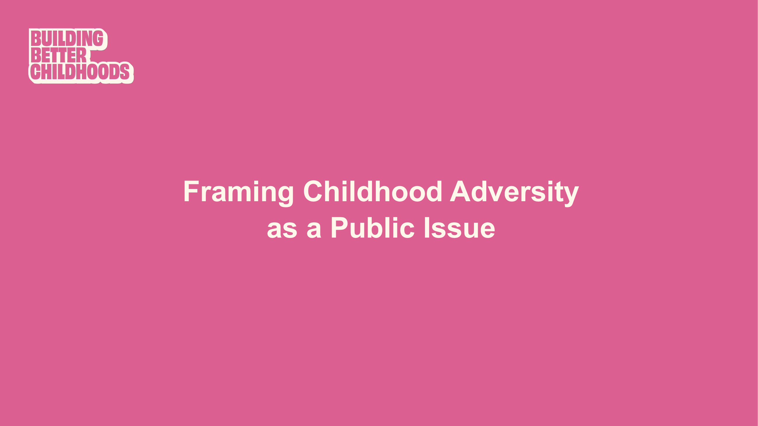
Notes:
Now we will go through each of the six recommendations. The first two are focused on framing child adversity as a public issue, rather than a private issue that is relevant only to people in an individual household or family.

Slide 9
Notes:
To make the story one where we all have a stake, FrameWorks recommends that we:
Lead with an aspirational values appeal. Consistently open messages with positive affirmations of what’s at stake – especially the ideas that children have tremendous potential and that we have a shared obligation to children.
Don’t use the scope or severity of the problem to engage people. On children’s issues, bleak facts and upsetting stories spark fatalistic attitudes or cause people to turn away to avoid discomfort. Avoid framing designed primarily to depict the harsh reality of adversity and its impacts.
Attribute responsibility more specifically when you can. Whenever possible, follow through on the generic appeal to collective responsibility by naming the sectors, agencies, or other systems-level actors who play a role.

Slide 10
Notes:
Framing science tells us we can’t identify policy solutions for children and families if we don’t see ourselves as part of that solution/shared responsibility.
Always talk about child adversity and child maltreatment in ways that emphasize shared fates.
Make the issue a story about “us,” not about “them.” Remind people that we all benefit from child well-being. Likewise, show that the consequences of childhood adversity are also shared.
Connect to our collective responsibility to children and remind people that our actions can maximize – or undermine – children’s potential.

Slide 11
Notes:
The way we begin a communication has a powerful effect, shaping people’s interpretation of all that comes after.
When we open with a statement of the problem, or even just the name of the issue, we prompt people to call up their existing associations. Concepts such as childhood adversity, child maltreatment, or early traumatic experiences come loaded with misconceptions about “bad parents.” This stigmatizes struggling families, reinforces stereotypes about marginalized groups, and leads people to mismatched solutions. And once these prior associations are brought to mind, we have made our persuasive task harder than it needs to be.
Leading with a values-based message can spark a more productive perspective. The values recommended here – Human Potential and Shared Responsibility – have been shown to have positive, statistically significant effects on public attitudes in previous FrameWorks experiments.
Messages expressing the value of human potential boost support for social services and family supports. Messages focused on collective responsibility increase people’s sense that child welfare is important and that action is necessary.

Slide 12
Notes:
For the second recommendation to show that childhood adversity is a public issue:
Be explicit about the processes that cause and stem from childhood adversity. Highlight big-picture social conditions that increase the risk of adversity, explain how they work, and connect the process to the problem it causes. Locate the problem in social conditions or widely shared experiences, not within households or families. Show how certain situations – such as financial stress, isolation, or behavioral health challenges – put pressure on caregivers’ capacity to engage positively with children.
When talking about racial disparities, don’t stop with data or an explanation of the biases that exist. Make sure negative data points are paired with brief explanations that point to root causes. Otherwise, the door is left open for deficit-based thinking about communities of color.
Connect the dots between aspects of structural racism that are becoming familiar to the public – such as police violence or lack of access to quality housing – and the ways those experiences can hamper safe, stable, and nurturing relationships. Prompt people to connect their concern for fairness with the effects injustice has on child and youth development and well-being.

Slide 13
Notes:
Context matters and helps to pull responsibility away from an individual’s behavior or responsibilities and into the collective responsibility frame.
The mechanisms that perpetuate childhood adversity are largely “invisible” processes, which makes it harder for people to see how underlying causes drive the problem. When we fail to explain how one thing leads to another, our audiences fill in “empty” causal slots for themselves.
On children’s issues, people usually fill in a story about the individual flaws and failings of parents.
On issues like racism or poverty, people often fill in a story about individuals or communities – not policies and systems – for disparate outcomes.
If we offer careful explanations, we can overcome this built-in tendency to reach for familiar answers and prompt people to pause and rethink their understanding of how something works.
By showing the link between a cause and its effect, explanations can lead people to recognize broader impacts and see why certain solutions lead to meaningful change.

Slide 14
Notes:
The next two recommendations help to explain that child adversity is a preventable problem.

Slide 15
Notes:
Emphasizing the dynamism of development is achieved by:
Creating a sense of urgency by emphasizing the time-sensitive nature of human development. Point out that children and youth are developing rapidly, and explain how the experiences at each stage have an impact on what happens next.
Emphasize that both risk and opportunity are present at every point in a child’s development – and be clear that systems and policies shape the outcomes.

Slide 16
Notes:
Three metaphors can help explain early development:
Brain Architecture. To help people appreciate why the early stages of life matter, compare child development to setting up the architecture of a house. Focusing on the brain allows communicators to leverage the latest science. This gives the sense that you’re providing new information, which can prompt people to reconsider their assumptions. CUE VIDEO on brain development after this slide https://www.brainstory.org/#modal-brains-built
Toxic Stress Response. To give people a way to grasp how adversity affects health and wellbeing, distinguish between the effects of everyday stress and “toxic stress.” Explain that chronic and severe adversity can create a toxic stress response that floods the body with dangerous levels of stress hormones.
Buffering. Describe protective factors as buffering children from toxic stress or the negative impact of risk factors. The words buffer/buffering aren’t used very often in everyday conversation, so they capture attention. They also paint a mental picture of an active intervention.

Slide 17
Notes:
When we say we need to take action to prevent childhood adversity, we find that prevention is a really hard concept for people to grasp. Its effects are very abstract – how do you explain a problem that didn’t happen? We need to talk about prevention in a way that makes it more real and tangible for people.
To get there, we have to consistently focus on the context that shapes family life and children’s experiences. Too often people persist in the assumption that the problem comes down to poor choices on the part of families - which makes it even harder to get across the impact of prevention.
For example, we know that much of the public sees neglect as just insufficient attention on the part of selfish or distracted parents. This frame of “the parents are the problem” makes it much harder for people to see how child neglect can be prevented.
Some of the helpful linguistic tips that Frameworks offers to support talking about prevention include:
Give concrete examples of what prevention looks like in action.
Instead of process verbs like “encouraging” use vivid action verbs like “equipping”.
Use “when words” like “now” and “today” to help focus attention on the present.
Show the futures we create by our choice to act or not act.
And finally, vary your vocabulary. Whenever possible, swap in synonyms and sayings for the standalone term “prevention.” For example, try describing prevention as “upstream solutions” or “working to get ahead of issues.”

Slide 18
Notes:
FrameWorks has recommended the use of the metaphor of “overload” so we can help people better relate to the conditions that families experience.
When you describe family experiences in the context of significant stressors such as housing insecurity, job loss, hunger, people can understand the burdens these bring.
We can then talk about how to lessen the load or manage the weight. This brings the focus to systems – i.e., overloaded vehicles - rather than individual shortcomings.
The more we can think and talk about the connections between the social determinants and conditions that lead to poverty or neglect, the more we can boost and reinforce the sense that problems can be prevented.
Interestingly, when Frameworks tested this with various audiences, they found it was particularly effective with parents who had experienced childhood adversity themselves because it gave them a way to think about the causes of their parenting styles without shame, guilt, or stigma.

Slide 19
Notes:
Let’s take a quick look at a short video that helps illustrate the concept of “overload.” This was produced for UK audiences so for reference, a “lorry” is a truck.
Video: Overloaded Parents (1 minute)
https://www.youtube.com/watch?v=hbRuzRS4AoY

Slide 20
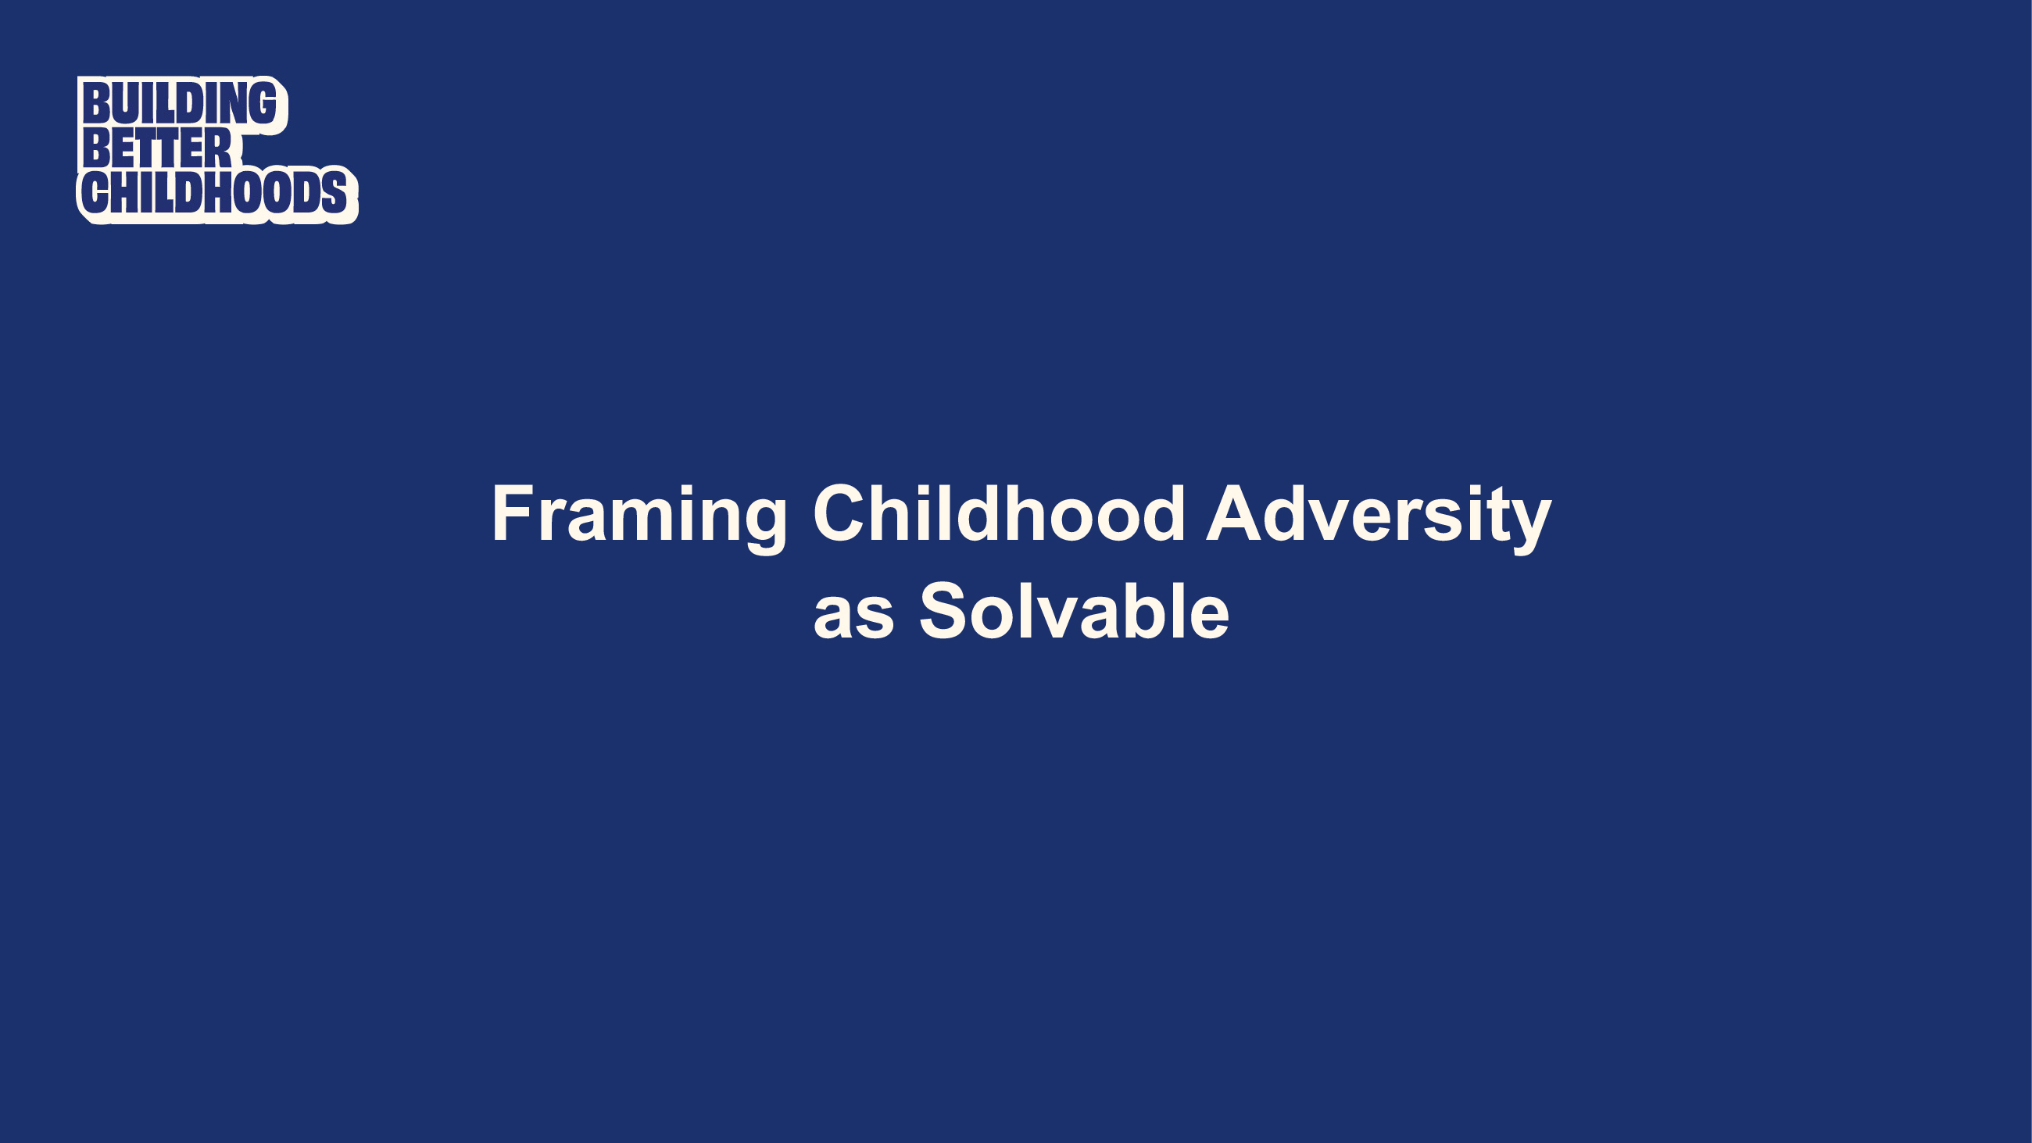
Notes:
This brings us to our third category of recommendations – the idea that child adversity is solvable.

Slide 21
Notes:
First, to counter the idea that the die is cast and that abuse and neglect are inevitable, we need to lift up the capacity for resilience among individuals. We need to avoid giving the impression that adverse experiences early in life are irreparable and automatically translate into negative outcomes.
That means highlighting the opportunities that enable the brain to rewire – this occurs not just early in a child’s development, but also as adolescents and new parents.
We need to emphasize the sense of counterbalancing the weight of adversity to tip the scales to positive outcomes.
To do this, explain the concept of resilience as “positive outcomes despite negative experiences” and help people see how resources and experiences can promote resilience.
Talk about what makes services more effective. Show what interventions at the individual, family, and community levels look like. Lift up community strengths and assets as important resources for building resilience.
And part of that is getting across that resilience isn’t just the burden or responsibility of individuals - it is a responsibility we all share.

Slide 22
Notes:
Recommendation 6 focuses on always including a proven or promising solution.
As communicators, our challenge is not getting across that a problem exists, but rather getting across that we can do something about it.
Propose concrete, actionable solutions that match the scope of the problem. Frame the problem as a systemic issue, then offer solutions aimed at “fixing conditions” instead of “fixing people.”
Champion solutions and programs that work, like shifts toward prevention in federal funding through Family First and other proven best practices like home visiting programs and Family Resource Centers.

Slide 23
Notes:
By infusing actionable, concrete solutions throughout our communications - through our tone, word choice and specific examples and case studies that illustrate that change is possible; we can fight back against fatalistic thinking.
It’s also important to match the level of solution to the level of problem. For example, people often say things like “in order to fix the child welfare system we need the political will to change.” Well, affecting political will means fixing political differences, which seems like a problem no one wants to take on right now.
Instead, we need to get in the habit of telling solution stories that can exemplify the potential and impact of interventions to lead to positive change.
This approach also helps shift the focus from individual responsibility toward our shared obligation to set up fair structures, effective systems, and equitable social conditions.

Slide 24
Notes:
Just to recap, if you remember nothing else…
Framing childhood adversity as a public issue (not a private one relevant only to individual households), preventable problem, and solvable problem are the main three take-aways for the recommendations. I find these three categories a helpful way to remember the recommendations.
Cue Julie’s Sweetland’s video 1:23:45-1:27:45 https://preventchildabuse.org/resources/webinar-reframing-childhood-adversity-promoting-upstream-approaches/

Slide 25
Notes:
This has been a very quick overview of the Frameworks child adversity brief. We want to encourage you to share your questions and comments that we will address after the presentation. You might want to consider:
Can you share any solution stories that derive from your work?
Any additional support you would need to be comfortable using recommendations?
How do these values and frames align OR differ from your organization's current framing?
Please continue to submit your comments and questions throughout the presentation, and we will connect with you about them after the presentation.

Slide 26
Notes:
We’ve been tracking some examples of well-framed communication in the media and want to share a few examples with you here. We will start with three.
The first one is an op-ed from the USA Today network and is written by leaders in Delaware’s children’s health system and at Children and Families First.
https://www.delawareonline.com/story/opinion/contributors/2021/04/29/delaware-kids-can-get-services-they-need-if-joe-biden-leads/4862617001/

Slide 27
Notes:
Our second example is an op-ed from the director of public child welfare in Marin County, California.
https://www.marinij.com/2021/04/14/marin-voice-to-prevent-child-abuse-we-need-to-invest-in-families/

Slide 28
Notes:
The third example is from Washington Post reporters and focuses on supporting foster parents and preventing removals of children from their parents.

Slide 29
Notes:
We’ve prepared three exercises to practice using the recommendations.
For exercise 1 and 2, we will show you two poorly framed paragraphs (for recs 1 and 2). In the chat box or in your notebook, please write down any words, phrases, or concerns about these paragraphs.
Then we will show you examples of better framed paragraphs and point out key concepts or differences.

Slide 31
Notes:
Now I will pause for one minute to give you a chance to make some notes in the chat box or your notebook.

Slide 32
Notes:
Read the better one out loud.
Notice the value statement and solutions.

Slide 34
Notes:
Prompt: Did they lead with a value?
I’ll wait another minute while you make some notes or write into the chat box.

Slide 35
Notes:
Read the better framed version out loud
Where are the external conditions?

Slide 36
Notes:
Now we have some example stories for you to review and tell us how to improve. We won’t give you “answers” for these paragraphs but encourage you to enter your comments into the chat box and share the examples with your colleagues to brainstorm on how they could be better framed to follow the recommendations we’ve covered here.

Slide 37
Notes:
Do you have comments on the framing or suggestions on how to improve this story?
I’ll wait another minute so that you can capture some of your thoughts.

Slide 38
Notes:
What about this one—how could it be better framed?

Slide 39
Notes:
Before we wrap up, we want to leave you with one more example of a well-framed message.
This one is from the New Republic and is in-depth coverage by a journalist of how the pandemic affected the child welfare system.
We want to be clear that this framing work has been useful during the pandemic to explain how families benefit from support and how external conditions can affect a family, but the utility of these recommendations can easily be applied to everyday struggles, such as an overload of stress, grief, unemployment, economic uncertainty, etc. All families need help sometimes, and it is our collective responsibility to support them, which allows children and families to thrive.
https://newrepublic.com/article/163281/pandemic-became-unplanned-experiment-abolishing-child welfaresystem?utm_source=social&utm_medium=facebook&utm_campaign=sharebtn&fbclid=IwAR1CwKmo_PlAd6hKsmvVjmLGXs6usm8DgPzpA9ccAqPatrmJpxSMv8rbaI

Slide 40
Notes:
Wait a few seconds

Slide 41
atempleman@social-current.org jjones@preventchildabuse.org
Notes:
Thank you all for joining us for today’s webinar. We hope you are leaving with some new ideas about ways to frame childhood adversity as a solvable, preventable, and public issue. Now, more than ever, it is important that we all do our part to promote supportive services that strengthen families. These include trusted community-based child abuse prevention programs, such as home visiting, community and parent cafes, and family resource centers.
We hope you will stay in touch with us and follow our organizations on social media. Please continue to share your experiences as you try out these new recommendations. Thank you all for the work you do everyday to support children and families, and thank you for being a part of our community.
Now we will hand things over to our moderator and begin our Q&A session.

