Slide 1

Firefighter Behavioral Health Alliance
“Saving Those Who Save Others”
Suicide/PTSD Prevention/Awareness
Jeff Dill, Founder, FFBHA
Presented by: Paul Bearce

Slide 2

Please Be Aware
Don’t be afraid of the “F” word
We will be talking about some tough topics
Some discussions may trigger some feelings or emotions that are uncomfortable
If this occurs, please excuse yourself and take a break
  Deep breathing exercises; meditation; take a walk
FEELINGS

Slide 3
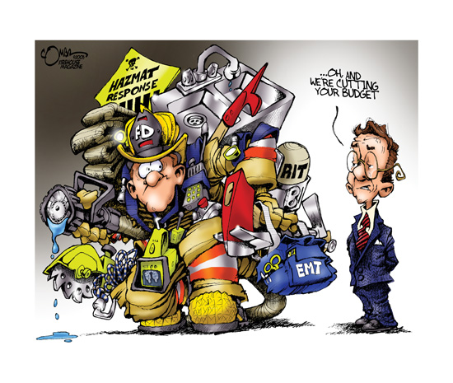
New Stresses in the fire service
We have become the “Swiss Army Knife” of public safety
Different fires, different pts, different buildings
The evolution to the “All Hazards” department
When a citizen has lost control – they will call the fire department – we are expected to bring calm to the chaos
New roles & responsibilities
Cultural obstacles
Studies have found stress-related mental health issues among first responders at a higher rate than the general population

Slide 4

New Challenges
COVID-19 changed how we do business
Full effects may not yet be realized
New viruses may be on the horizon
Safety protocols will have to be adapted
New safety concerns can create more stress on the responder

Slide 5
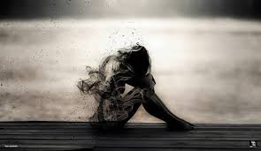
…On Their Worst Day
In your career you may witness:
  Pain and suffering of the sick and injured
  Death of adults or children
  Families and friends of victims who suffer loss of their loved one
  Wide-spread destruction of property
  People in deep despair
“you will have the privilege of seeing someone take their first breath, and witnessing others take their last breath,”
- Kyle Thornton, NM EMS Bureau Chief

Slide 6

Est Population in 2021-1775

Slide 7
What is culture?
According to Merriam-Webster:
Culture is “the set of shared attitudes, values, and practices that characterize an institution or organization..

Slide 8
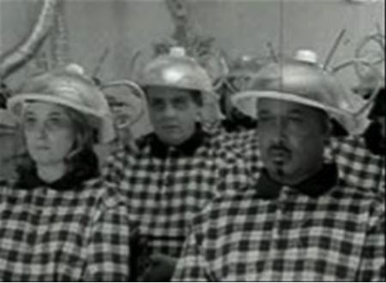
What We Are Taught
Many things we were taught in our training have had to adapt to new methodologies backed by science:
Fire attack
Fire Behavior
Ventilation
Rescue profiles
How to seek help when the job becomes overwhelming…
Copyright - FBHA 2011 All Rights Reserved

Slide 9
Cultural Brainwashing - How it manifests in our departments
Stigma of asking for help.
Stigma of counselors lacking knowledge about the “job”.
Officer’s/FF’s lack of training/communications.
Lack of access to counseling services.

Slide 10


The conversation has started
Yellow Ribbon Report – Under the Helmet – Volunteer & Combination Officers Section
  2017
  IAFC.org
16-Life Safety Initiative – National Fall Firefighters Foundation
  2004 & 2014
  Firehero.org
Tacoma FD – “the Call We Carry”

Slide 11
Solving the problem
Technical
Adaptive
Problems that can be solved by the knowledge of experts.
Solved with existing resources.
Easy to identify.
Requires change in values, beliefs, and approach to work.
No quick fixes.
Difficult to identify.
Climate change
Paradigm shift
Train and prepare
Communicate a constant message
Top-down & bottom-up

Slide 12
What is happening to us?
Recognition of mental health issues are changing the fire service

Slide 13
Anxiety
Anxiety – “A feeling of apprehension and fear characterized by physicals symptoms such as palpations, sweating and feelings of stress.”
Panic Disorders
Obsessive Compulsive Disorder
Post Traumatic Stress Disorder – Now in the Traumatic category of the DSM-V (Diagnostic and Statistics Manual)
Social Phobia or Social Anxiety Disorder
Stress – “Forces from the outside world impinging on the individual”. (Environment, relationships, finances, career)

Slide 14
Stress/Anxiety
FBHA Survey – 71.43% (942 Responses)
Sleep Deprivation
Promotions
Shift Work
Emergency Incidents
Family issues
Financial issues
Union
Management
Retirement
Injury/Death

Slide 15
Anger
ANGER - is "an emotional state that varies in intensity from mild
irritation to intense fury and rage," Charles Spielberger PhD.
How many know of people in your department who have this issue?
Explode at possible changes in the firehouse, police stations, hospitals, EMS station
Express themselves loudly and in a very angry voice
How do you deal with them?
Suppressed anger- can surface in unexpected situations
often directed at innocent bystanders - a phenomenon known as
Displacement.
Cognitive Dissonance – Feeling ambivalent, psychological
tension, threat to sense of identity or self

Slide 16
Depression – 41.3%
Mood: anxiety, apathy, general discontent, guilt, hopelessness, loss of interest, loss of interest or pleasure in activities, mood swings, or sadness
Sleep: early awakening, excess sleepiness, insomnia, or restless sleep
Whole body: excessive hunger, fatigue, loss of appetite, or restlessness
Behavioral: agitation, excessive crying, irritability, or social isolation
Cognitive: lack of concentration, slowness in activity, or thoughts of suicide
Weight: weight gain or weight loss
Clinical depression requires a medical diagnosis

Slide 17
Addictions – 17.4%
Alcohol
Gambling
Smoking
Eating
Pornography
How to Get Help?
Counseling
In-Patient Treatment
Out-patient Treatment
Know your insurance

Slide 18
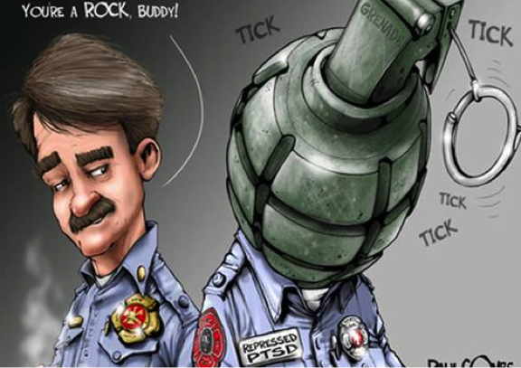
POST TRAUMATIC STRESS
PAUL COMBS

Slide 19

What is PTSD?
PTSD is included in a new category in DSM-5,
Trauma- and Stressor-Related Disorders. All of the conditions included in this classification require exposure to a traumatic or stressful event as a diagnostic criterion.

Slide 20
What ptsd is not
Experiencing the effects of exposure to trauma
“An abnormal reaction to an abnormal situation is normal behavior.”
― Victor Frankl, Man's Search for Meaning

Slide 21
PTSD vs Moral Injury
Humans born to do good-help others
Trained in the fire/EMS service to save lives
Over time seeing death, feeling helpless in saving lives
Betrayal by Management/Others/Self
Leads to human emotions of guilt, shame, failure to do good
Military stats state more suicides come from M. I. than PTSD

Slide 22
FFBHA White Paper on
Moral Injury (2023)
“Moral injury is the damage done to one’s conscience or moral compass when that person perpetrates, witnesses, or fails to prevent acts that transgress one’s own moral beliefs, values, or ethical codes of conduct.” (Litz et al., 2009)
479 FFs from across the county responded to survey.
Nearly 58% of FFs reported experiencing a major morally injurious event.
50% admitted feeling emotionally detached or isolated.

Slide 23
Add to That…
Primary Trauma
  Direct exposure to incident
Secondary Trauma
  Witnessed incident
Vicarious Trauma
  ‘Hear the stories’
Transference
  ‘See ourselves in them’

Slide 25
Negative/maladaptive stress coping mechanisms:
Illicit drugs
Pain Medicines
Alcohol-Receptors in the brain
Smoking-Nicotine Receptors
Over-Eating
Communications
  Lack of, or ineffective
Self-destructive, risky behaviors
SUICIDE

Slide 26
Why are we killing ourselves???
Are FFs more likely to die by suicide than from LODD?

Slide 27
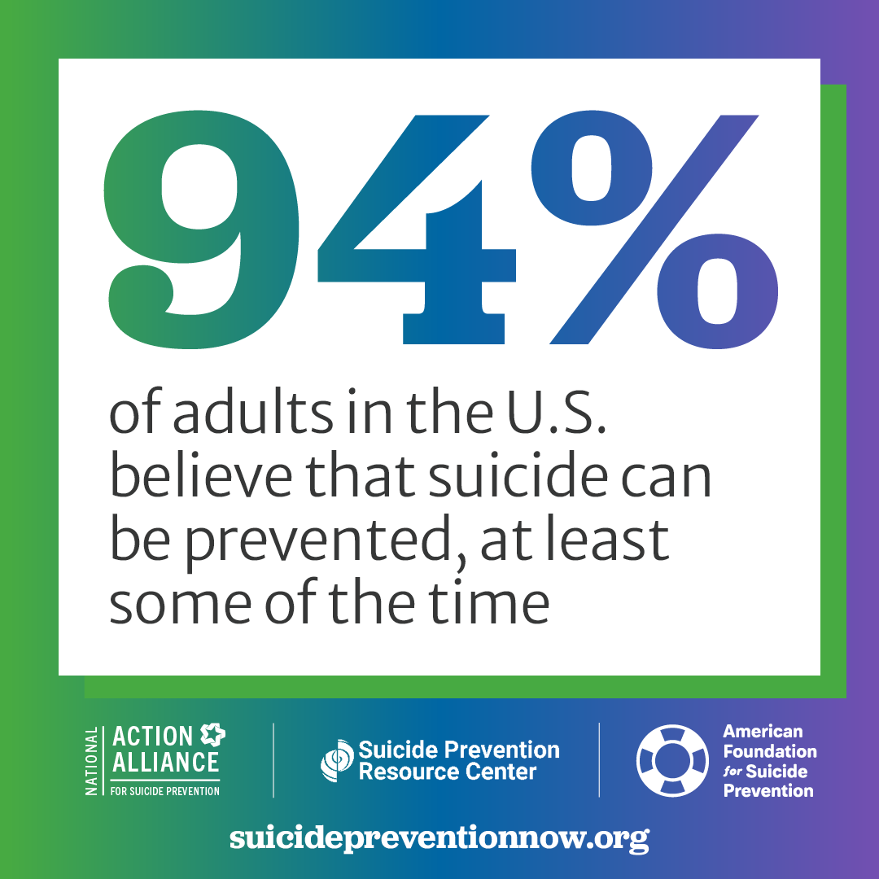
Is suicide a preventable form of death?

Slide 28
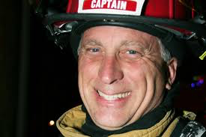
David Dangerfield: Facebook Oct 15, 2016
“PTSD for Firefighters is real. If your loved one is experiencing signs get them help quickly. 27 years of deaths and babies dying in your hands is a memory that you will never get rid off. It haunted me daily until now. My love to my crews. Be safe, take care. I love you all.”

Slide 29
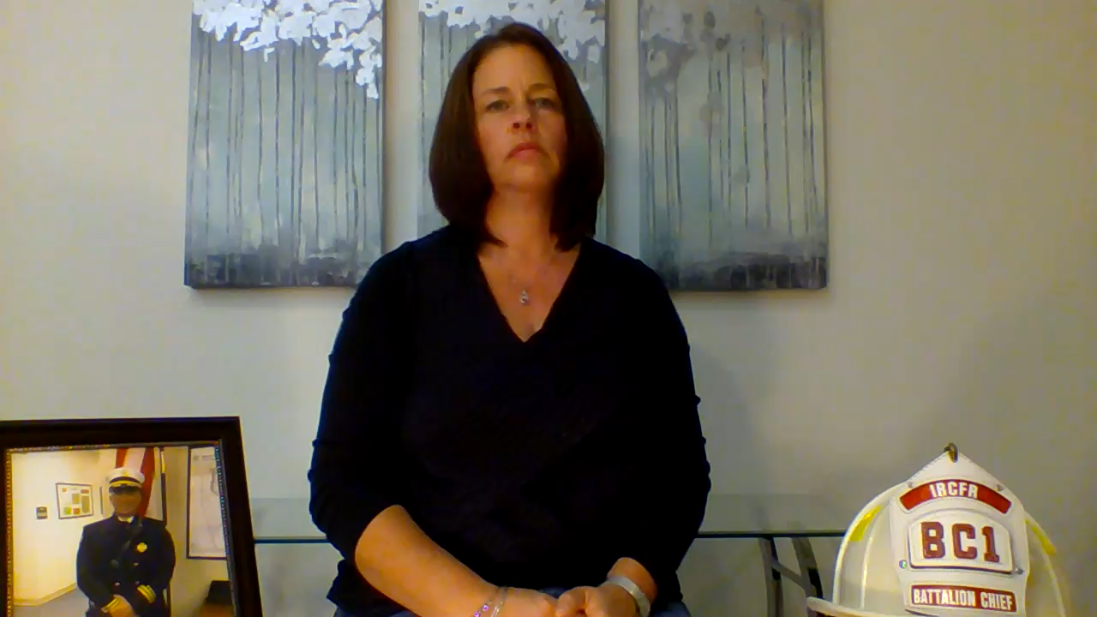
Leslie Dangerfield

Slide 30
Words Matter
“Died by suicide”
  Important on how we phrase this
  “Committed” has a negative connotation (i.e. committed a crime, committed a sin…)
  It matters to family, friends, colleagues

Slide 31

Suicide Globally
Approximately 700,000 people die each year by suicide
One in every 100 deaths = suicide
Men 2X more likely
Almost 60% before age 50
Persons with depression 20X
Global phenomenon

Slide 32
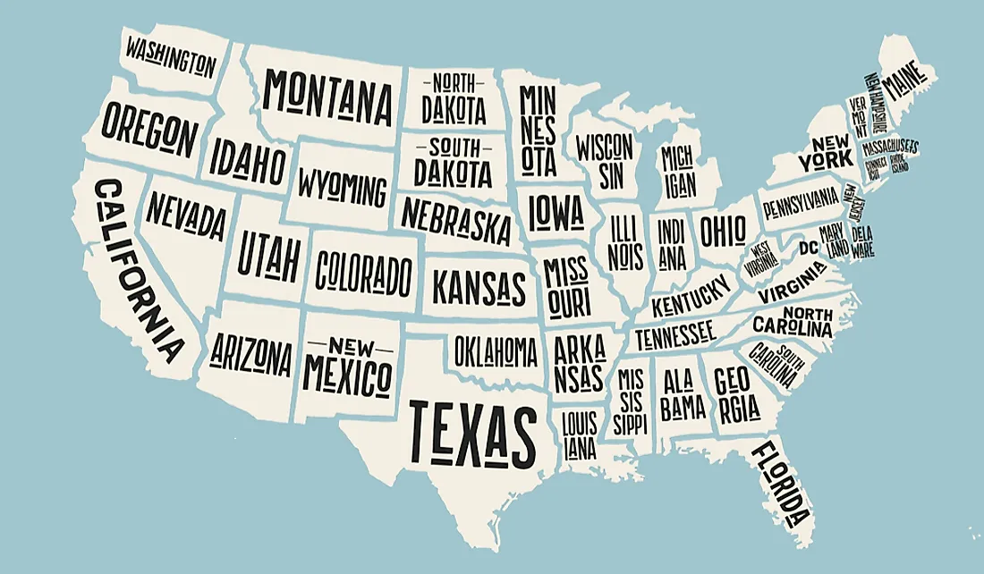
Suicide Statistics in the U.S.
  45,979 suicide deaths in 2020
  13.48 per 100,000
  130 per day
  Firearms accounted for nearly 53% of all suicide deaths
  White males accounted for
  the majority of all suicide deaths

Slide 33
Breaking Down Who Dies by Suicide
Gender (2020)
  Men more likely to die by suicide than women (3.9x)
  Women attempt more often than men (2x)
Age (2020)
  25-34 years of age—greatest # of deaths, then 75-84
  Teen rate stable over last ten years (under age 15)
Race (2016)
  Non-Hispanic Whites highest rate; American Indian/Alaskan Natives next
  Asian/Pacific Islanders lowest among males
  Non-Hispanic Blacks lowest among females
Caution: suicide crosses all socio-economic, race, gender, and ages. It is an equal opportunity form of death.

Slide 34
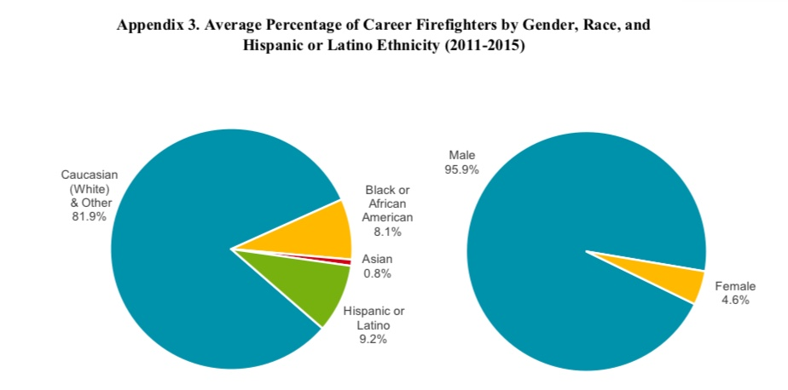
Do you see the relationship between suicides in general population and suicide among firefighters?
Notes:
Any place, career, organization, etc., that is male dominated could have an increased risk of suicide. Stress how the fire service is working toward diversity and changing the demographics, but it is still a largely male-dominated profession with a small number of minorities.
NFPA Data is on career firefighters. Majority of firefighters in US serve as volunteers or paid-on-call.
Note: This data is current as of the publication date of the manual. Trainer should update the slides with the most current information via suicide prevention resources cited here and in the resource section of this manual.

Slide 35
Suicide rates by state
Suicide rates above 19/100,000*
  Wyoming 30.46
  Alaska 27.18
  Montana 25.88
  New Mexico 24.18
  Idaho 23.23
  Colorado 21.53
  South Dakota 21.10
  Utah 20.81
  West Virginia 19.45
Suicide rates below 9/100,000*
  District of Columbia 5.44
  New Jersey 7.10
  New York 8
  Massachusetts 8.35
  Rhode Island 8.39
  Maryland 9.22
  Connecticut 9.33
  California 9.98
*afsp State Statistics 2020

Slide 36
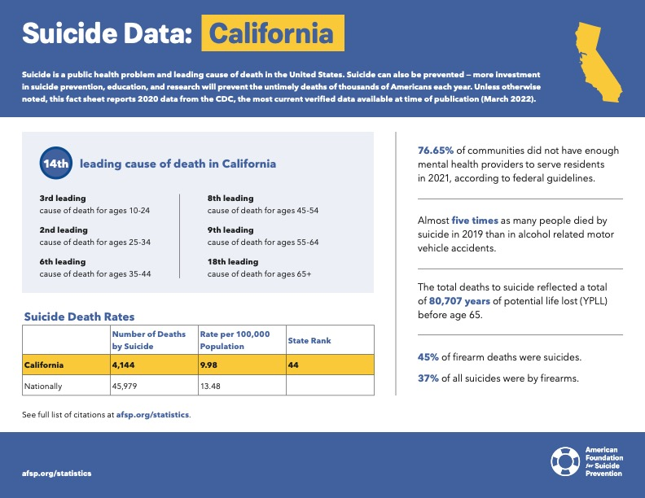
FFBHA has validated 111 FF/EMS suicides in California

Slide 37
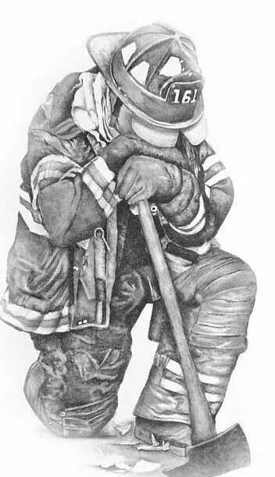
The numbers
Firefighters– 1,839
EMS – 13
Dispatch - 2
1,854

Slide 38
Notes:
38

Slide 40
Notes:
40

Slide 41
FBHA Top 5 Suicide Warning Signs:
Think “RAILS”
  Recklessness/Impulsive
  Anger-Displacement
  Isolation
  Loss of confidence in skills/abilities
  Sleep Deprivation
Lost their sense of humor
Notes:
41

Slide 42
Be aware…
Loss of Identity
Lack of Belonging
Lack of Purpose
Notes:
26 years as a FF, LT, Capt., B/C, A/C?

Slide 43
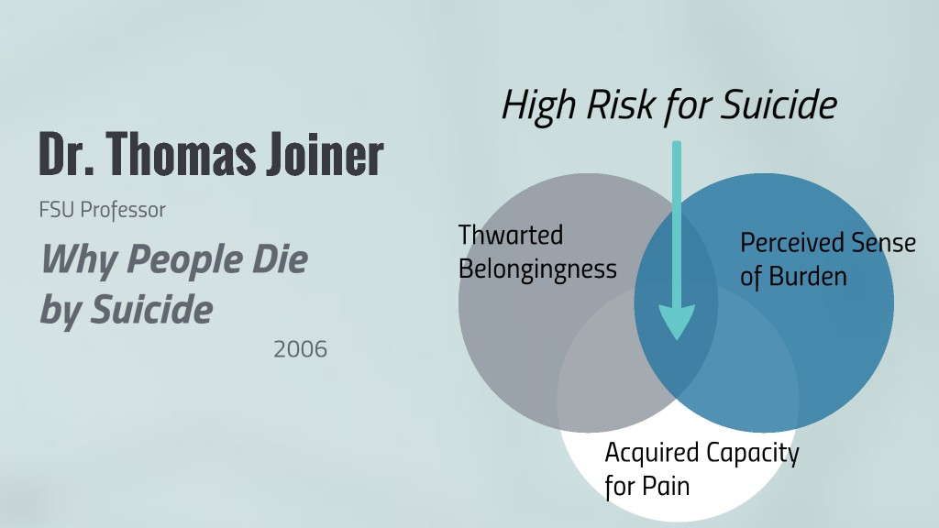
Dr. Joiner’s Theory

Slide 44

Thwarted Belongingness
Unattached
No longer integral part of a unit
Not relevant in group
Untouchable
Different
With but not among group
Devalued
Do you have a ‘socially awkward’ member of your department?

Slide 45

Perceived Burdensomeness
Existence is draining family, friends
World would be better without me
People will carry on
Void will not be noticeable
Death will improve someone else’s life

Slide 46
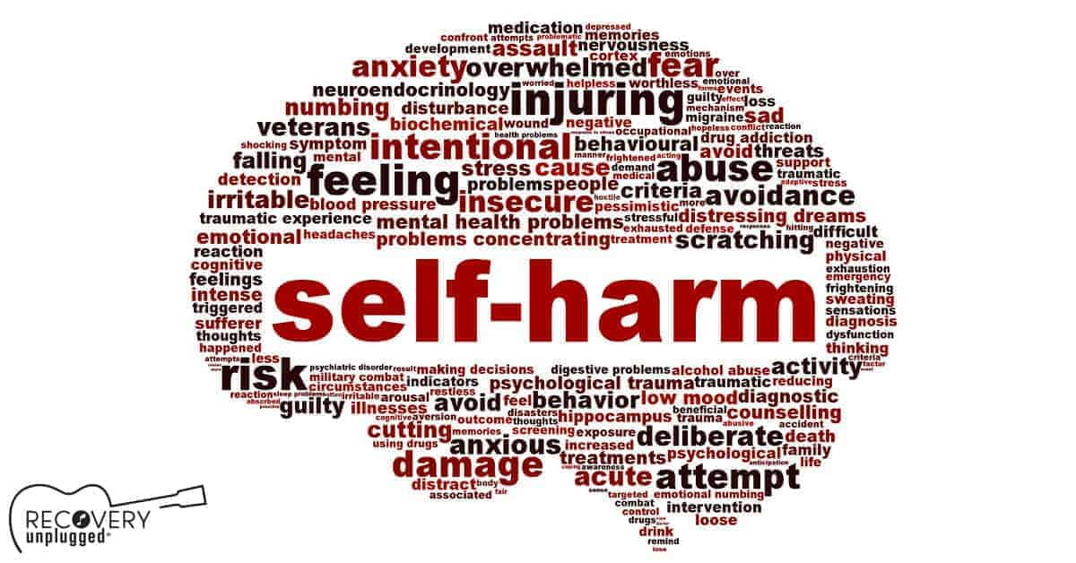
Capacity for Pain
Experience and disposition overcome fear
Learned capacity for pain
Overexposure
Trivialization of trauma
Progressive desensitization
Normalizing death
Trained fearlessness about the body
Do FFs already have an increased capacity for pain?

Slide 47
Risk Factors for General Population
Chronic stress
Recent loss or multiples losses
Trauma or abuse
  Adverse Childhood Experiences
Poor self-image
Isolation
Interpersonal conflicts
Change in marital status
Stigma about seeking help
Anxiety and/or depression(diagnosed or undiagnosed)
Experienced rejection or failure
Recent discharge from mental health facility
Impulsive or aggressive tendencies
Humiliation or any threat to status
Previous suicide attempt; family history
Exposure to suicidal behavior
Influence of others who died by suicide
Chronic pain or physical illness
Incarceration or threat of incarceration

Slide 48
Protective Factors for General Population
Accessible and appropriate mental health resources
Problem-solving skills
Restricted access to lethal means
Feeling a sense of purpose in life
Coping skills
Strong spiritual or religious faith
Stress management skills
Sense of hope
Strong connection to family
Diverse community of friends and social contacts
Education in impulse control
Living in a community that promotes help-seeking behavior
Skills to address stigma of help seeking

Slide 49
Risk Factors in Firefighters
Intrinsic (from within)
  Risk takers
  Savior syndrome
  Solution-oriented
  Distorted world view
  Occupational trust
  Erosion of normalcy
  Responsibility absorption
  Capacity for pain
Extrinsic (from outside)
  Schedules
  Fatigue
  Uncontrolled risk
  Public perception
  Access to services
  Fire service culture
  Vicarious trauma
  Access to means
  PTS

Slide 50
Protective Factors in the Fire Service
Cohesive units
Courageous
Compassionate
Compliant
Survival training
Sense of belonging
Revered occupation
  Passionate
  Resilient
  Altruistic
  Ability to disassociate
  Empathic
  Flexible
  Image Armor

Slide 51
FBHA Recommendation
Be Direct and Challenge with Compassion

Slide 52
Where to Go For Help
Traditional Approaches
  E.A.P.
  Fire Dept. Chaplains
  Peer Support
  Medical Provider
  Online Platforms and hotlines
  Family Support Networks
Maybe Consider These Alternatives:
  Self-care
  Mindfulness Based Stress Reduction
  Pet Therapy
  “Give Back” programs
Asking for help is a not a sign of weakness . . .
It is a courageous, life-saving step.

Slide 53
Action Plan-Advice for Your Departments
Confidentiality!!
Open communication in the home & at work
  Talk to trusted family, friends, colleagues
Education – Attend seminars and workshops
Leadership by respected peers
Find out about resources available to you
DEVELOP A PEER SUPPORT/CISM TEAM
DEVELOP A BEHAVIORAL HEALTH PROGRAM

Slide 54
Pyramid of Support
In-patient Care
Focused Employee Assistance Program (EAP)
Licensed Behavioral Health Provider
Occupational Medical Provider
Peer Support Team & Chaplain Program
All Personnel – Awareness & After Action Reviews of every call
Family Support Network – Awareness & Recognition
Company Officer Level – PFA/MHFA
…similar to Revel’s model for behavioral health help

Slide 55
What we can do daily to help our team
Call
Be vigilant to the types of calls that trigger the team and be proactive in helping them.
Debrief
Debrief after tough calls- talk to each other one-on-one to see how everyone is coping
Offer
When one of your crew is having personal issues let them know that you can see that it is affecting them, offer an ear, or give them the information on where they can get help.

Slide 56
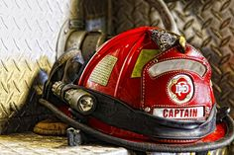
The Role of the Company Officer
As the company officer goes, so goes the department
Unique position.
How well they should know their crews, tips on how to get there.
Mandatory reporting.
How to refer someone for help.

Slide 57

Seek a Professional
Don’t let the stigma associated with seeking help keep you from talking to a counselor or therapist
If you don’t find the right-fit at first, try another provider
Having someone with knowledge of your unique career field can lead to more open and honest discussions about your issues
It is OK, to not be OK

Slide 58
Listening Skills- (Practice, Practice)
Listen first-Difficult to do (80/20 rule)
Allow them to talk
Avoid “jumping in” with responses
Avoid perfect solutions - offer options - let them choose
Focus on skills of communications – listening and responding
Silence is ’Golden’
Notes:
58

Slide 59

Which Describes Your Department?
(A. Suck It Up! This is what you signed up for
(B. Let’s hug it out – it’ll all be OK
(C. It’s part of the job and we’ll make sure your prepared and supported

Slide 60
Dealing W/ Stress
Avoid Caffeine, Alcohol, Nicotine – stimulants, increase stress
Physical Activity
Sleep hygiene
Relaxation Techniques
Talk to someone regarding your stress
Take control – What is the event? What are my options on how to handle the event?
Manage your time – Do not procrastinate
Learn to say “NO”

Slide 61
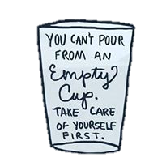
Resiliency and Self-Care
Being happy and healthy in your career is your goal
You cannot pour from an empty cup
If you are not 100%, you won’t be there for yourself, your family, your friends, your colleagues, and the community

Slide 62
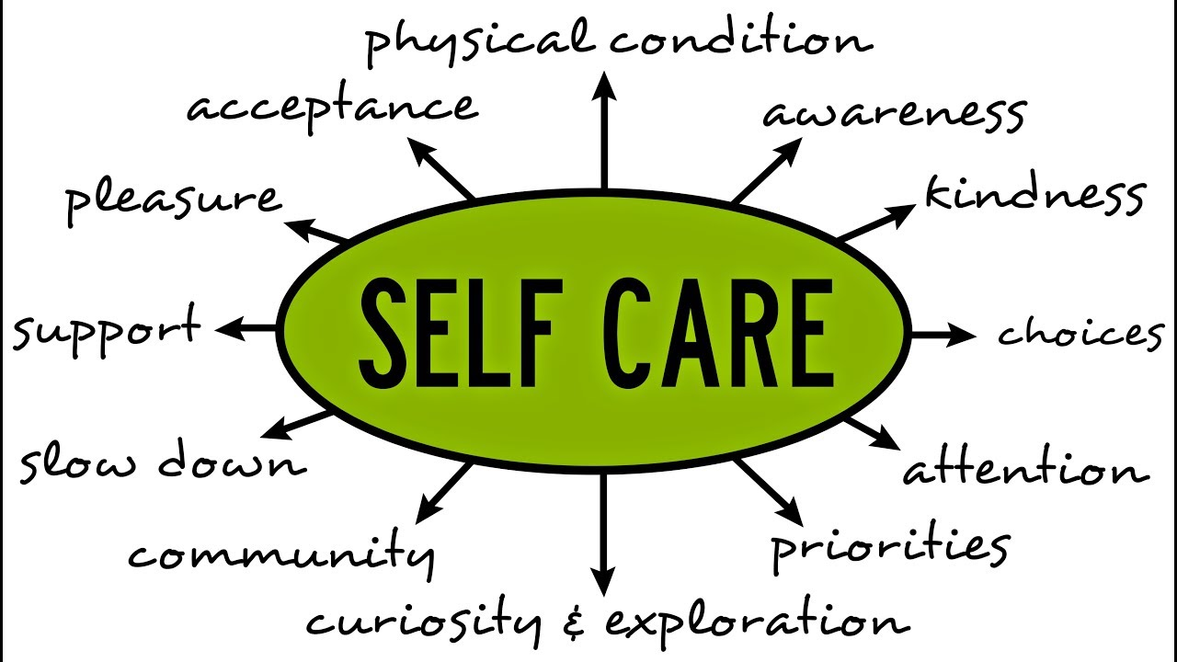
Eat healthy
Exercise
Enjoy down-time
Read
Go for a walk or hike
Get outside
Do ‘nothing’
Think outside the box
  Yoga
  Meditation
  Mindfulness Based Stress Reduction
  Journaling

Slide 63
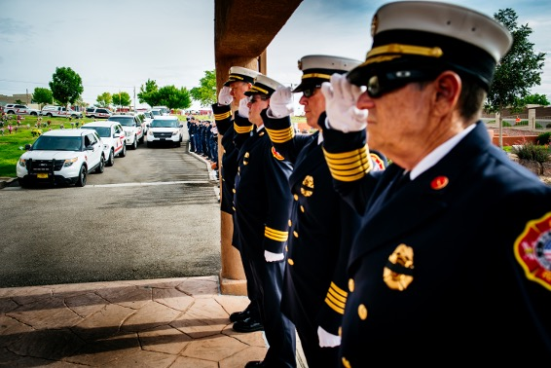
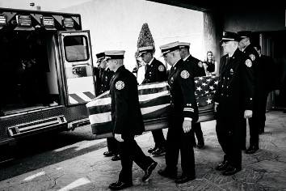
Some Thoughts about postvention
Suicide death leads to unanswered questions
Anger, guilt, blame
Victim AND perpetrator
Death will be in the shadows of a LODD
Lt. Colin Rice
E.O.W. 06.03.2019

Slide 64
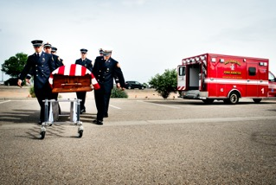
Some Thoughts about postvention
Lessons learned:
  Take care of family
  Take care of department
  Official notifications
  Blame and questions
    Don’t take it personally
  Honor life of service
    Have protocol in place
    Honor guard, flag, bells
    Neighboring agencies stepped up to assist
  Anniversaries are important
  Healing is on-going

Slide 65
Emergency Contact Form
They matter!
E-version preferred
Accessible 24/7
Updated annually

Slide 66

THINGS TO REMEMBER
Your career and life is a journey. . . Not a destination
You are MORE than your uniform or badge
There will be peaks and valleys
How you cope with the accumulation of daily problems will define you and your future
P

Slide 67
One more quote
“…there was no need to be ashamed of tears, for tears bore witness that a man had the greatest of courage, the courage to suffer.”
  ― Viktor E. Frankl, Man's Search for Meaning

Slide 68
Resources
Firefighter Behavioral Health Alliance
  FFBHA.org
9-8-8 – everyone should know this number
Safe Call Now
  SafecallnowUSA.org
Text: 741741-Badge
Responder Health
  Responderhealth.com
National Volunteer Fire Council – Share the Load Program
  NVFC.org
  NVFC/FBHA-National Directory of Counselors-www.ffbha.org under Resource Tab
Chaplain Programs
  Firechaplains.org
Fire Strong
  Firestrong.org 844-885-FIRE

Slide 69
SUMMARY
Learn to Listen
Plan for a Happy and Healthy Retirement
Family/Relationships Matter!
Do Not Bury What Burdens You

Slide 70
Contact
Jeff Dill
  jdill@ffbha.org
Paul Bearce
  pbearce@ffbha.org

